Slide 1
Resident Retention
Results
Importance
Reasons for move outs
Key components of retention
Renewal process
Renewal Increases
Retention Plan

Slide 2
Retention Results…. Check your folder for results
Retention Trends
 | 2015 | 2016 | 2017 | 2018
ABC I | 60% | 64% | 60% | 60%
ABC II | 56% | 66% | 66% | 63%
APP | 64% | 64% | 62% | 62%
TAA | 52% | 47% | 48% | 54%
ATC | 55% | 58% | 51% | 44%
ASA | 52% | 66% | 58% | 50%
BHPP | 70% | 68% | 68% | 79%
AOD | 33% | 42% | 39% | 44%
SCA | 42% | 41% | 48% | 53%
TT I | 45% | 56% | 52% | 54%
TT II | 52% | 47% | 48% | 43%
TTM III | 43% | 43% | 38% | 55%
AWN | 67% | 50% | 54% | 45%
AJH | 50% | 57% | 53% | 43%
BBP | 45% | 49% | 57% | 54%
PAL | 52% | 57% | 49% | 49%
GAP | 49% | 49% | 48% | 52%
ABX | 41% | 44% | 47% | 44%
MOP | 68% | 75% | 79% | 56%
PHR |  | 49% | 43% | 47%
Total | 52% | 55% | 53% | 52%

Slide 3
WHY IS RESIDENT RETENTION IMPORTANT
REDUCES EXPENSES- Average cost to turn an apartment?
STABILIZES THE PROPERTY
ASSISTS IN LEASING TO FUTURE RESIDENTS
REDUCES STRESS ON PERSONNEL

Slide 4
Reasons why Residents move-out
Employment change
Purchasing a home
Life style change- Household composition size
Skip/Eviction
Transfers
Less than 10% of residents move out due to rental increases. The rental increase is usually NOT the issue… IT”S THE PERCEIVED VALUE!!!
Price only matters in absence of Value………

Slide 5
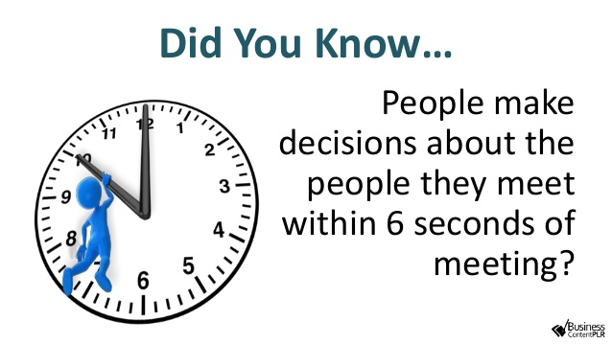
Does your property have a successful resident retention program?
Ask yourself these questions?
Do newcomers and residents feel welcomed and at home?
Do you have a standard move-in day process?
Do your residents know the names of the management and maintenance staff?
Does your staff know many of the residents by name?
Do your residents typically know their neighbor by name?
Do you have a maintenance follow up program in place?
Do you have strong turnout for your activities?
How well does your staff handle renewal increases?
If you were not employed at your community, would you live there?

Slide 6
A successful Resident Retention Program consists of the following:
Customer Service
Move-in Day
Maintenance Follow-up
Resident Retention
Resident Appreciation
Marketing
Renew

Slide 7
Resident Retention
Customer Service: Office and Maintenance
Acknowledge residents when on property
Thank Residents when they do something special
Remember something unique about each resident- children, pets,etc.
Resident Birthday/Thank you cards
Move-in Day:
Sign Lease prior to move-in day
Walk the unit to make sure their home is perfect
Provide a welcome letter
Have the keys and paperwork ready
Make sure their new home is perfect
Move-in gift
Review emergency maintenance procedure
Walk them to their new home
Work order follow up
Follow up with completed work orders either daily or weekly

Slide 8
Resident Retention
Marketing
Resident Referral flyers/bandit signs
Referral flyers on packages
Referral reminders on social media
Resident Appreciation-Create a sense of community- keep them informed.
Stay connected through notes, phone calls, birthday cards, newsletters, follow up,
Update the residents on any positive changes going on within the community via social media
Communicate with the resident to find out….
Recommendations for improvement, events, and any concerns
Resident events
Resident appreciation week
Monthly or quarterly based on your property size
Examples: candy bar, coffee bar, breakfast on the run ,door decorating contests, ice cream socials, egg hunts, pictures with Santa, pet parades, pet parties, Halloween carnival, pool BBQ, book club, yard sale, etc.
Renewal:
Just Checking Door hangers: 120 days before renewal expires. 120 prior to renewal you do a inspection of unit checking for any repairs. Any repairs you take care of immediately (light bulbs, mini blinds, drip pans, ect.) .This will also allow you to check for upgrades that could be used in renewal negotiations

Slide 9
Renewal Process
Renewal Timeline
120,90,75,45,30,0
Convenience
E-sign renewals, deliver lease, phone calls, email
MTM Notification/Fees
Renewal Gifts
Renewal Incentives
Communication
Be consistent and persistent in your resident retention approach

Slide 10
Renewal Timeline
90 Days
Fill out the renewal form
If requesting an amount less than the auto increase you will need to provide a reason in the comment section
Send to PMT for approval by the 20th of every month
Renewal Binders!
60-75 Days
Send initial renewal letter: Sample letters are located on the marketing library website
Informal letter- invite the resident to the office to discuss their upcoming lease renewal
Formal Letter- Presents the renewal and all the pertinent details.
Renewal color flyer
40-60 Days
Call, Email, or Send a note reminding them of their upcoming renewal and why they love living at your property!
You can also send them a flyer emphasizing the cost of moving
30-45 Days
If you haven’t heard from the resident:
Send them either the formal or informal letter depending on what you originally sent
It may be time to mention the incentive
Also a good time to layout the MTM fees

Slide 11
Renewal Timeline
15-30 Days
Expiration is right on top of us! Chances are they just forgot so send them a letter reminding them of the incentives as well as the MTM fees.
Also send a copy of the lease to their door, and they can return to the office
5-15Days
WE ARE OUT OF TIME!!!
CALL, CALL, CALL
KNOCK on doors
STAY late one night
Send them the acknowledgement letter that they will be going MTM and ask that they return it to the office
0 Days
Change their lease to MTM and charge all the associated fees
Send them one last letter giving them a short time period to sign the renewal and avoid paying higher fees.
Courtesy Call

Slide 12
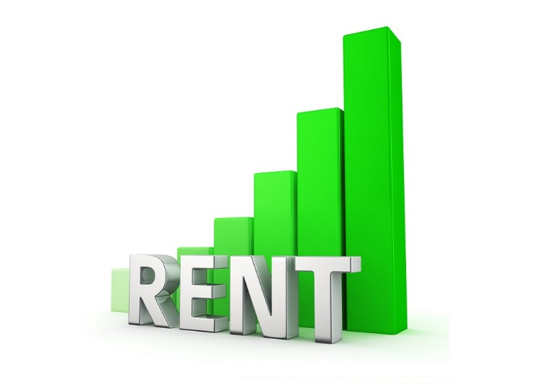
SOME HELPFUL WAYS TO OVERCOME RENEWAL INCREASES??
It’s All about relationships
Keep a Positive Attitude - Your property is worth it!
Justify the increase to the resident - Help the resident understand the increasing cost of living. Every home is unique.
It’s not just what you say, but the WAY you say it:
Do NOT use form letters
Get personal - Use their name, let them know how important they are to your community.
Use the right words - try “renew” instead of “expire”, use “your home” instead of “the apartment”
Convince the resident that it cost a lot to move - the cost of moving flyer
Use renewal concessions if needed
In the end be sincere, understanding, and prepared!

Slide 13
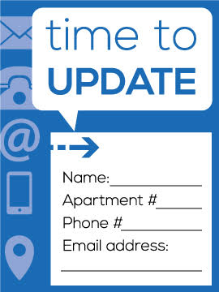
Renewal Reminders
Update the resident’s contact info and inform them of any positive changes going on within the community
Communicate with the resident to find out…
Recommendations for amenity improvement recommendations
Recommendations for community events
Any other recommendations or concerns they may have
Find FUN and INNOVATIVE ways to get the resident’s attention, and get them into your office to renew.
Be UNIQUE and present the renewal in a way they haven’t seen before. MIX IT UP!!!
Don’t hesitate to get with the Marketing department for ideas and assistance.
DON”T just give the renewal incentive for the sake of giving one. KEEP IT IN YOUR BACK POCKET TO USE IF NEEDED!!!
Be very clear in your communications, and COMMUNICATE… COMMUNICATE… COMMUNICATE…

Slide 14
Retention plan worksheet
Pull out the retention plan worksheet in your folders
Your folders will contain all the reports needed to complete this activity
Managers and Maintenance supervisors should work together and submit one plan to pmt.
Time: 15 mins

